Slide 1
RE3: Designing Experiments
UIUC ECON 474 Econometrics of Policy Evaluation

Slide 2
Agenda
Reading for next lecture:
Ch 7.1, 7.2
Designing Randomize Experiments
Review of hypothesis testing
Experimental choices
A/B Testing
Coding example

Slide 3
Hypothesis Testing
Power: It’s over 9,000!

Slide 4
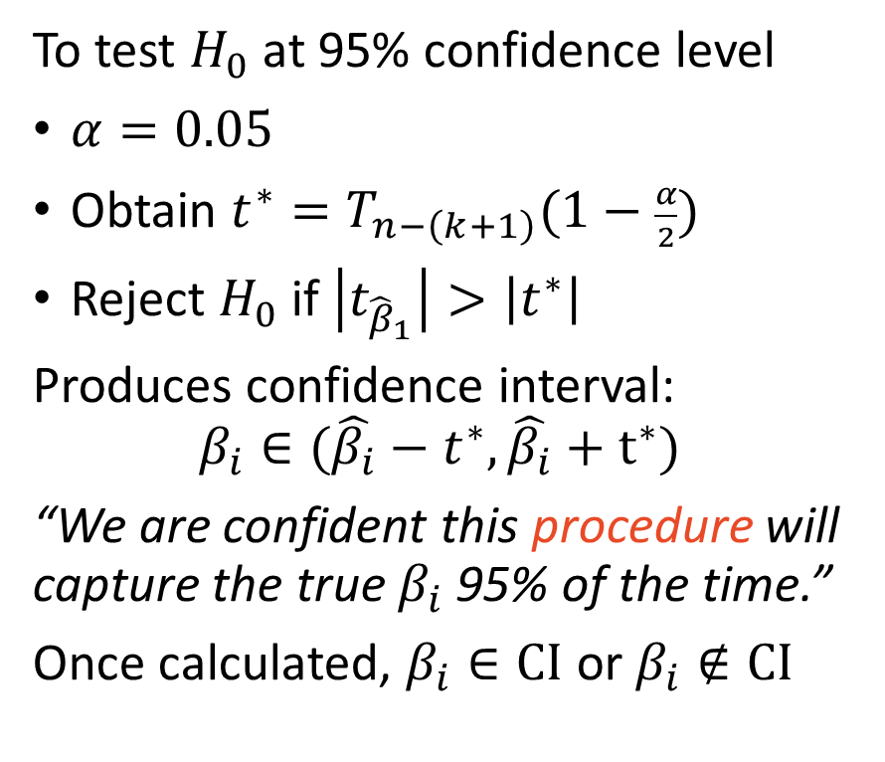
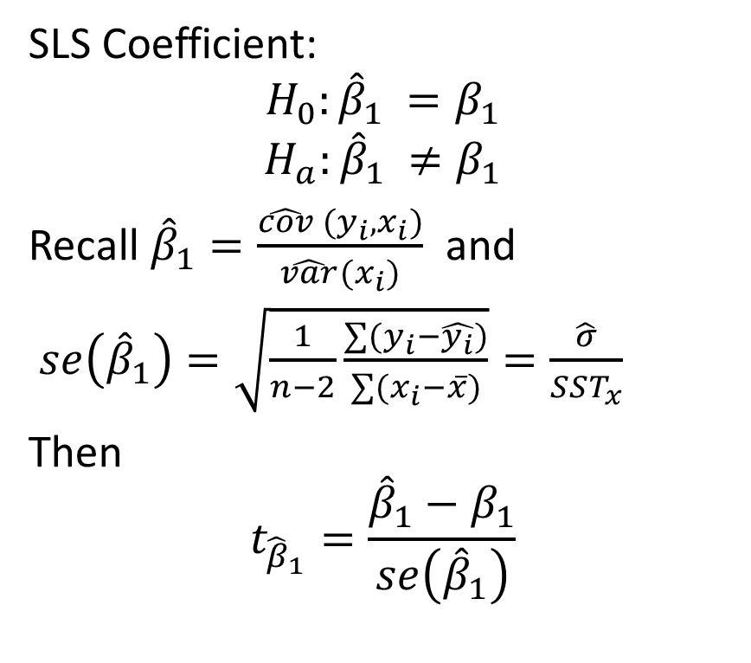
Hypothesis Testing Review
SLS Coefficient:
$$H_{0}:{{\hat{β}}_{1}}_{ }=β_{1}$$
$$H_{a}:{{\hat{β}}_{1}}_{ }≠β_{1}$$
Recall ${\hat{β}}_{1}=\frac{\hat{cov} (y_{i},x_{i})}{\hat{var}(x_{i})}$ and
$se\left({\hat{β}}_{1}\right)=\sqrt{\frac{1}{n−2}\frac{∑(y_{i}−\hat{y_{i}})}{∑(x_{i}−\overline{x})}}=\frac{\hat{σ}}{SST_{x}}$
Then
$$t_{{\hat{β}}_{1}}=\frac{{\hat{β}}_{1}−β_{1}}{se\left({\hat{β}}_{1}\right)}$$
To test $H_{0}$ at 95% confidence level
$α=0.05$
Obtain $t^{∗}=T_{n−\left(k+1\right)}(1−\frac{α}{2})$
Reject $H_{0}$ if $\left|t_{{\hat{β}}_{1}}\right|>\left|t^{∗}\right|$
Produces confidence interval:
$$β_{i}∈(\hat{β_{i}}−t^{∗},\hat{β_{i}}+t^{∗})$$
“We are confident this procedure will capture the true $β_{i}$ 95% of the time.”
Once calculated, $β_{i}∈CI$ or $β_{i}∉CI$

Slide 5
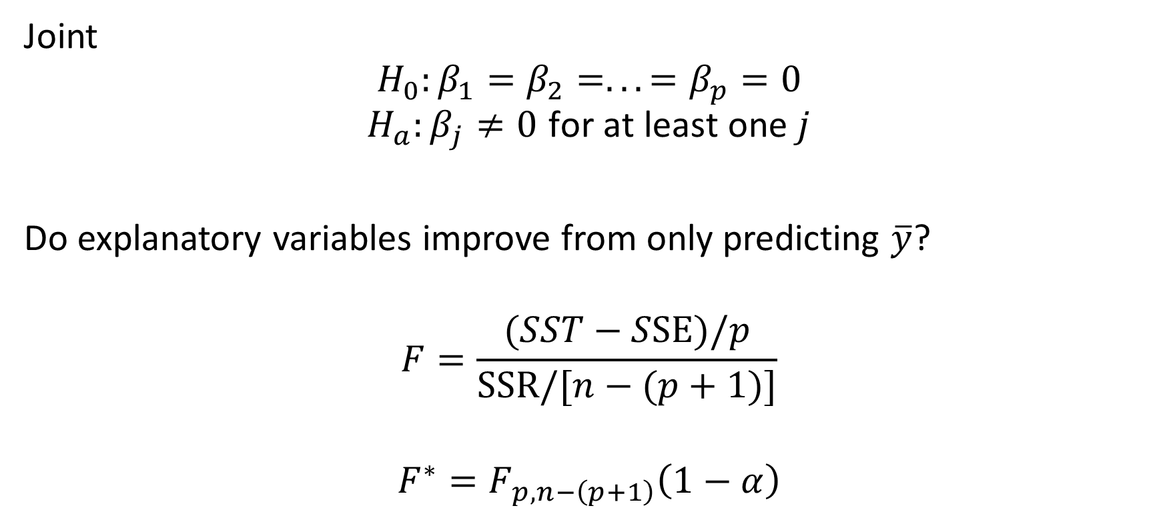
Hypothesis Testing Review
Joint
$$H_{0}:β_{1}=β_{2}=...=β_{p}=0$$
$$H_{a}:β_{j}≠0 \text{for} \text{at} \text{least} \text{one} j$$
Do explanatory variables improve from only predicting $\overline{y}$?
$$F=\frac{(SST−SSE)/p}{SSR/[n−(p+1)]}$$
$$F^{∗}=F_{p,n−\left(p+1\right)}\left(1−α\right)$$

Slide 6
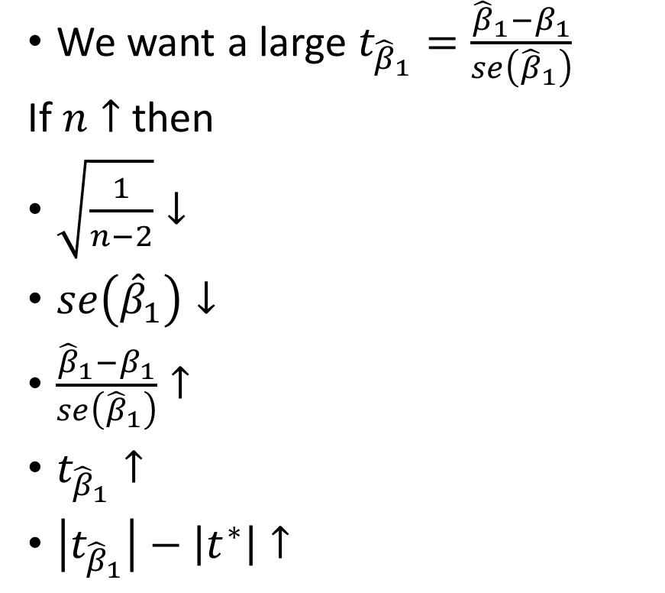
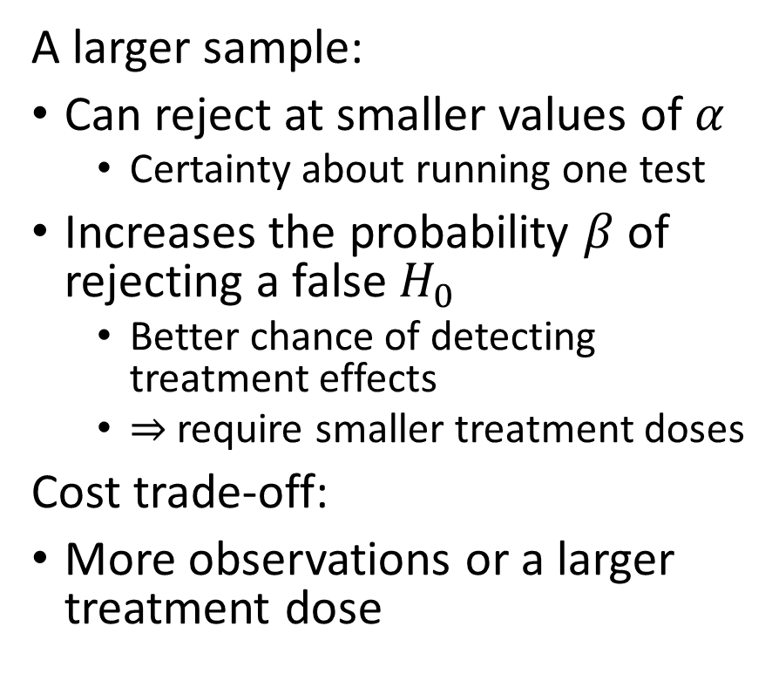
The path from sample size to rejecting a false $H_{0}$
We want a large $t_{{\hat{β}}_{1}}=\frac{{\hat{β}}_{1}−β_{1}}{se\left({\hat{β}}_{1}\right)}$
If $n↑$ then
$\sqrt{\frac{1}{n−2}}↓$
$se\left({\hat{β}}_{1}\right)↓$
$\frac{{\hat{β}}_{1}−β_{1}}{se\left({\hat{β}}_{1}\right)}↑$
$t_{{\hat{β}}_{1}}↑$
$\left|t_{{\hat{β}}_{1}}\right|−\left|t^{∗}\right|↑$
A larger sample:
Can reject at smaller values of $α$
Certainty about running one test
Increases the probability $β$ of rejecting a false $H_{0}$
Better chance of detecting treatment effects
$⇒$ require smaller treatment doses
Cost trade-off:
More observations or a larger treatment dose

Slide 7
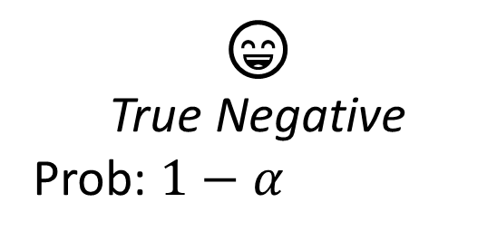
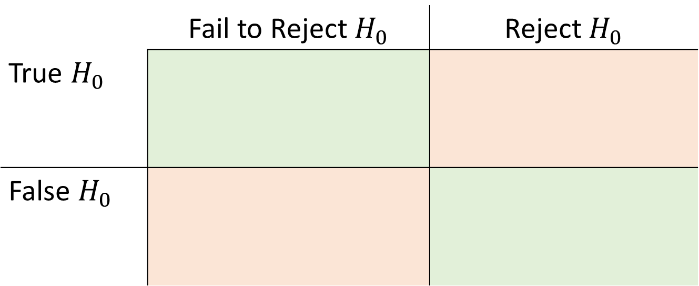
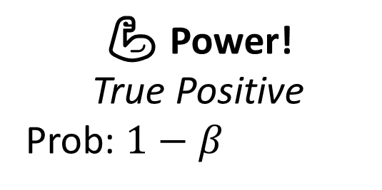
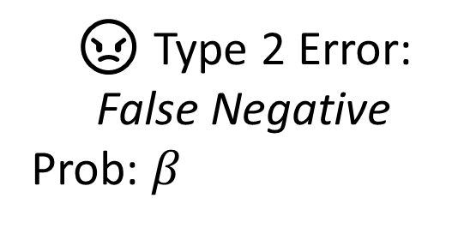
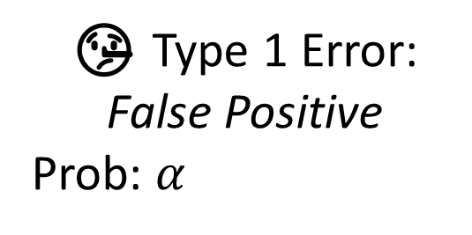
Types of Error
 | Fail to Reject $H_{0}$ | Reject $H_{0}$
True $H_{0}$
False $H_{0}$
😄
True Negative
Prob: $1−α$
🤥 Type 1 Error: False Positive
Prob: $α$
😠 Type 2 Error:
False Negative
Prob: $β_{ }$
💪 Power!
True Positive
Prob: $1−β$

Slide 8
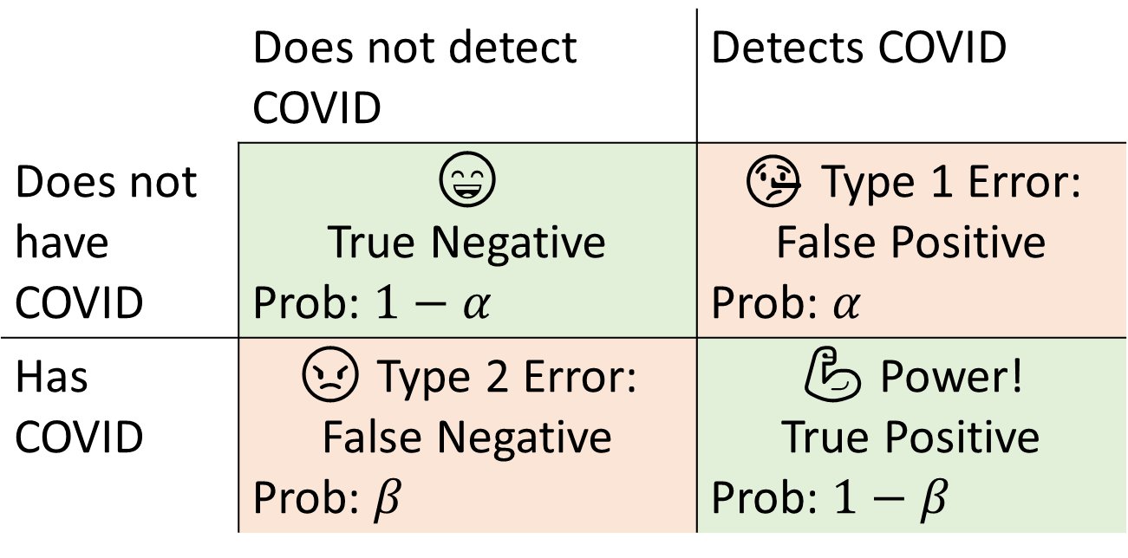
Types of Error - COVID
 | Does not detect COVID | Detects COVID
Does not have COVID | 😄 True Negative Prob: $1−α$ | 🤥 Type 1 Error: False Positive Prob: $α$
Has COVID | 😠 Type 2 Error: False Negative Prob: $β_{ }$ | 💪 Power! True Positive Prob: $1−β$

Slide 9
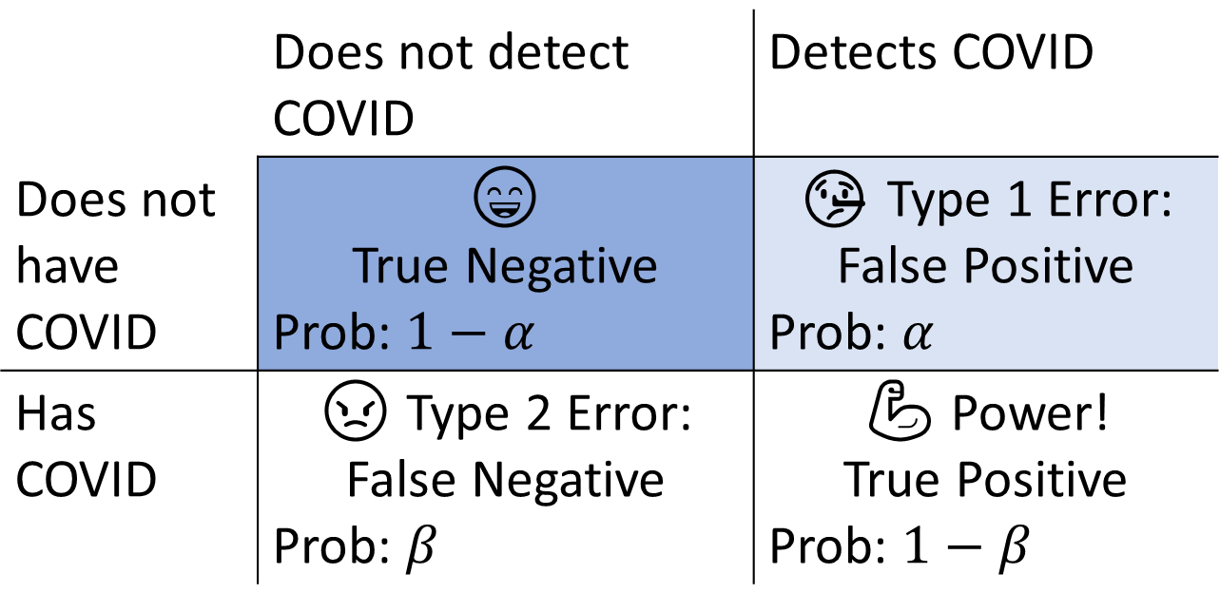
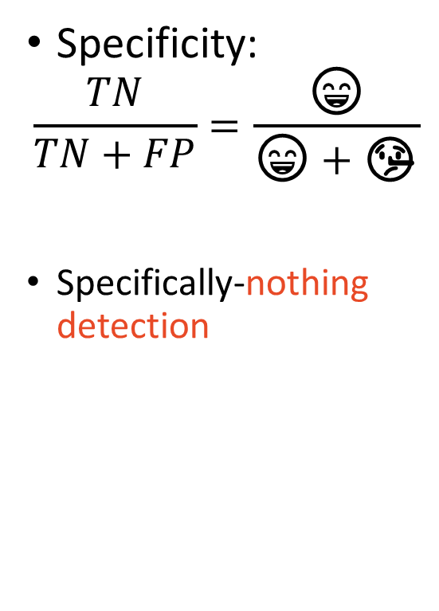
Diagnostics – Specificity
 | Does not detect COVID | Detects COVID
Does not have COVID | 😄 True Negative Prob: $1−α$ | 🤥 Type 1 Error: False Positive Prob: $α$
Has COVID | 😠 Type 2 Error: False Negative Prob: $β_{ }$ | 💪 Power! True Positive Prob: $1−β$
Specificity:
$$\frac{TN}{TN+FP}=\frac{\text{😄}}{\text{😄}+\text{🤥}}$$
Specifically-nothing detection

Slide 10
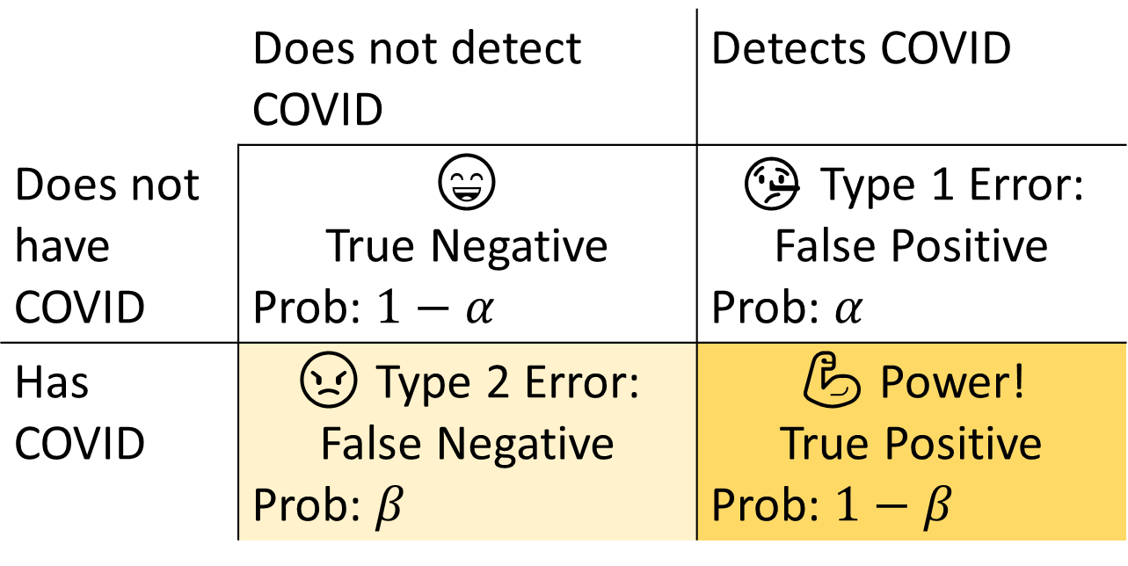
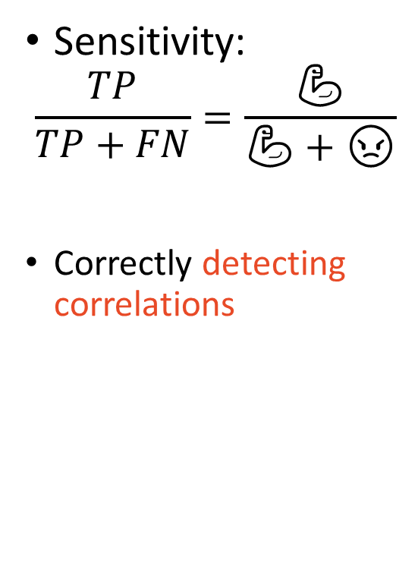
Diagnostics – Sensitivity
 | Does not detect COVID | Detects COVID
Does not have COVID | 😄 True Negative Prob: $1−α$ | 🤥 Type 1 Error: False Positive Prob: $α$
Has COVID | 😠 Type 2 Error: False Negative Prob: $β_{ }$ | 💪 Power! True Positive Prob: $1−β$
Sensitivity:
$$\frac{TP}{TP+FN}=\frac{\text{💪}}{\text{💪}+\text{😠}}$$
Correctly detecting correlations

Slide 11
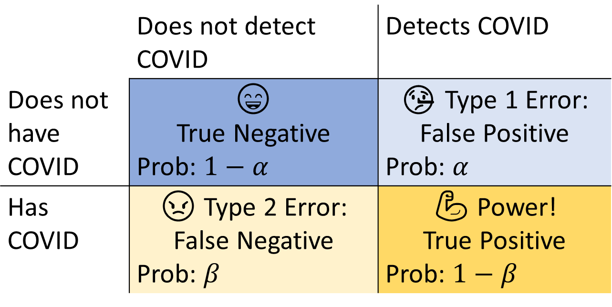
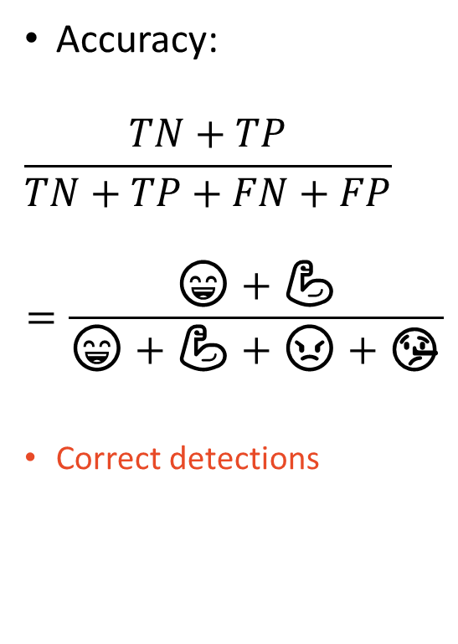
Diagnostics – Accuracy
 | Does not detect COVID | Detects COVID
Does not have COVID | 😄 True Negative Prob: $1−α$ | 🤥 Type 1 Error: False Positive Prob: $α$
Has COVID | 😠 Type 2 Error: False Negative Prob: $β_{ }$ | 💪 Power! True Positive Prob: $1−β$
Accuracy:
$$\frac{TN+TP}{TN+TP+FN+FP}$$
$$=\frac{\text{😄}+\text{💪}}{\text{😄}+\text{💪}+\text{😠}+\text{🤥}}$$
Correct detections

Slide 12
Experiment Decisions
The Basics

Slide 13
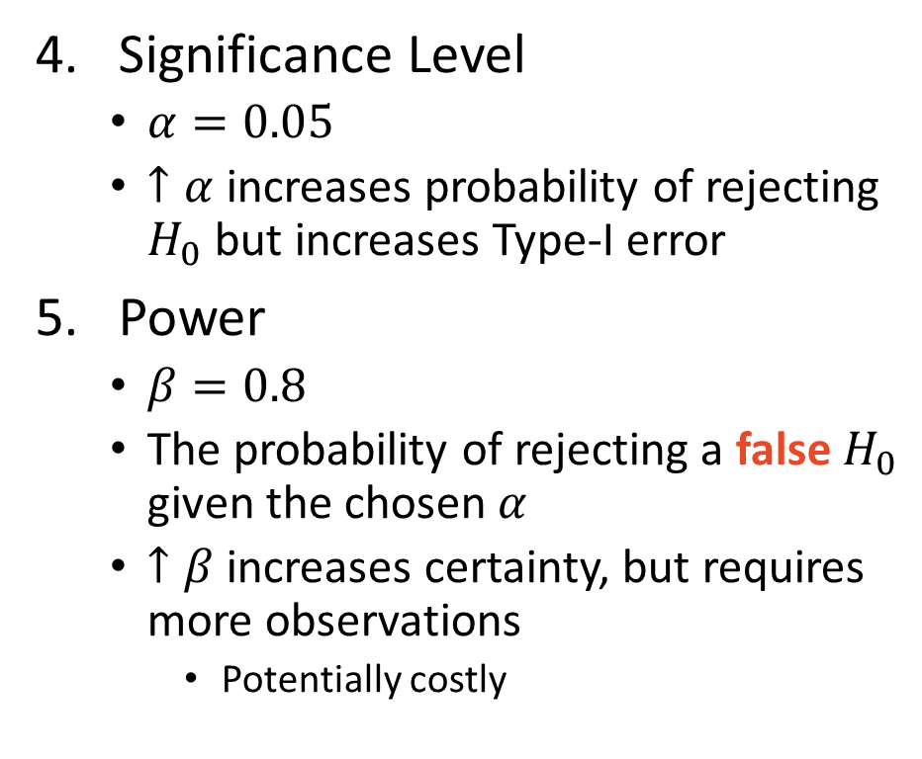
Fundamental Choices
Statistical test
Most likely regression (e.g., t-test for a coefficient)
Current value for control group
To help determine the necessary treatment effect size (therefore treatment dose size)
Control-Treatment Split
Typically 50/50, but not necessary
Can also have multiple treatment arms like Thornton (2008) (not covered)
Significance Level
$α=0.05$
$↑α$ increases probability of rejecting $H_{0}$ but increases Type-I error
Power
$β=0.8$
The probability of rejecting a false $H_{0}$ given the chosen $α$
$↑β$ increases certainty, but requires more observations
Potentially costly

Slide 14
The validities of your empirical results
Before you finish the planning phase, you need to think about two types of validity of your results
Internal validity – Your empirical strategy identified causal effects for the population studied
Did you obtain a causal effect (ATE or ATT?) or just a correlation?
External validity – Your identified causal effects apply to populations different than those in the study
If you study the effect of a tax break on mom-and-pop shops like Bread Co., does that effect apply to large companies like Coca-Cola?
These two concepts apply to all types of analysis (RE, IV, RDD, DiD, etc.)

Slide 15
A/B Testing
Industry has fancy names for things that already exist in the scientific community

Slide 16
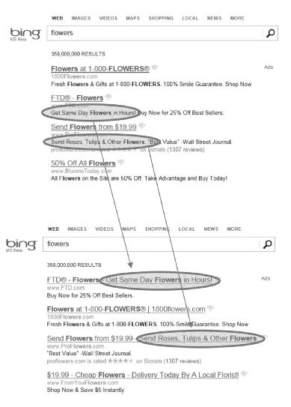
It’s just a t-test, but here are some neat examples
Changing Bing’s ad display increased revenue by 12% ($100,000,000)

Slide 17
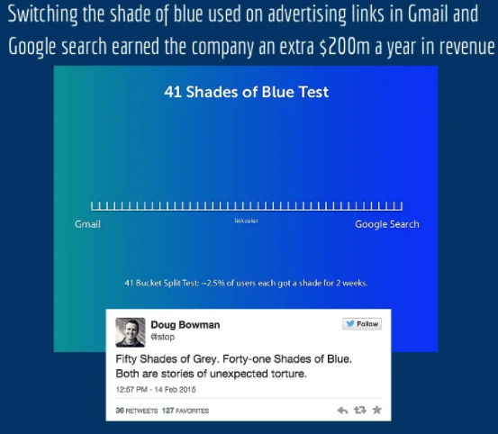

It’s just a t-test, but here are some neat examples
In 2004, Amazon placed a credit-card offer on the home page.
The team decided to run an experiment moving the offer to the shopping cart page, showing simple math highlighting the potential savings.

Slide 18
Today’s Coding Example
Back to Thornton 2008 and a Hypothetical Design

Slide 19
Overview
How to design an experiment with treatment size constrains
Workshop: Thornton 2008
Assume incentive effects on learning HIV status are “true” population statistics (ignoring clustering issue)
What is the minimum sample size required for the experiment?
What power and significance level could Dr. Thornton been aiming for without prior knowledge?

